Slide 1
Spatial Proteomics and Epigenomics
Prof. Jean Fan

Slide 2
Lesson Objectives
Learn about spatial proteomics and epigenomics
Analyze and visualize a mystery spatial omics dataset together

Slide 3
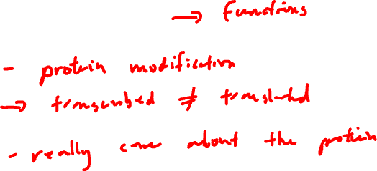
Why protein?

Slide 4
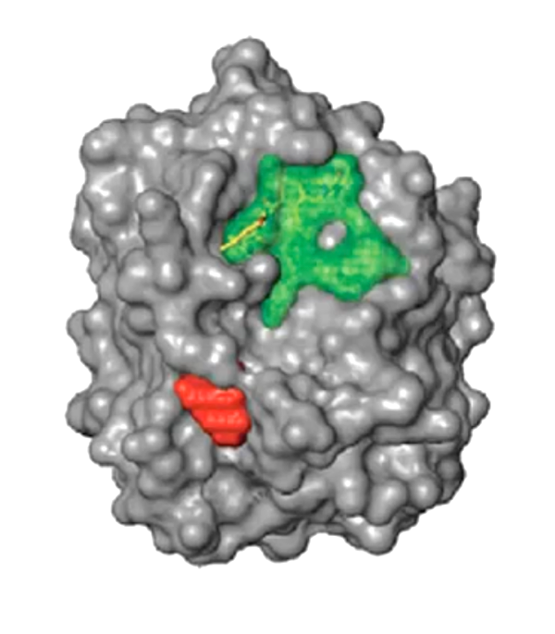
How can we detect proteins?
Protein
Epitope
(antigenic determinant)

Slide 5


Protein epitopes can be identified with antibodies
(primary) Antibody

Slide 6
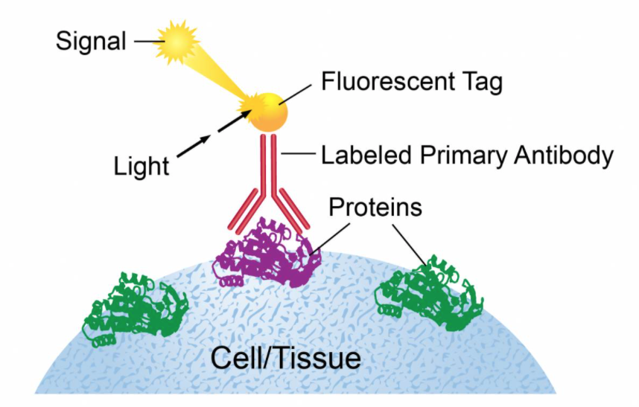

Ex. Immunofluorescence

Slide 7
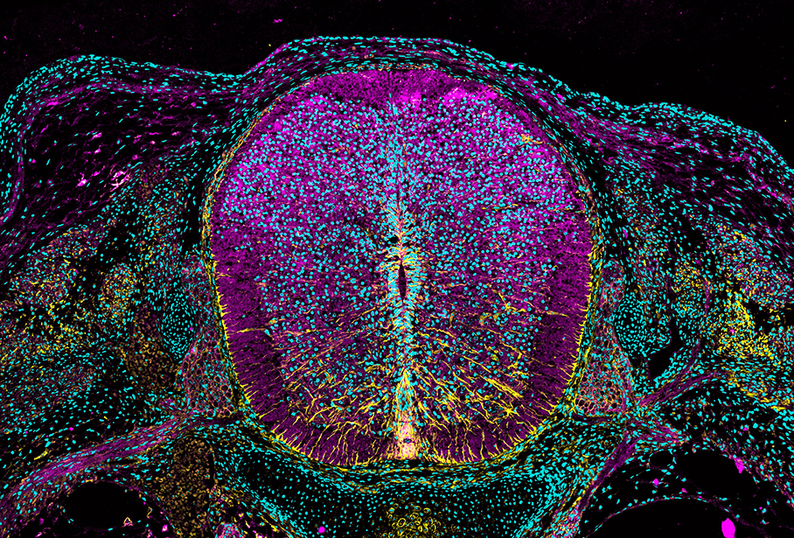
https://www.cell.com/pictureshow/immunofluorescence-ii
Vimentin (yellow)
N-cadherin (magenta)
Dapi (cyan)

Slide 8

What are antibodies? How are they made?

Slide 9
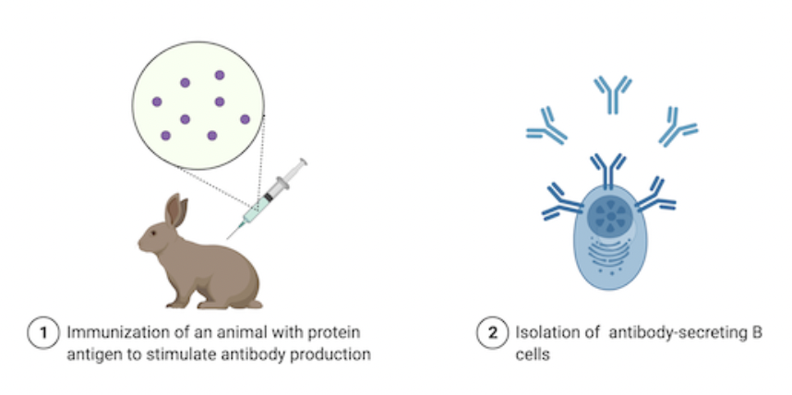
What are antibodies? How are they made?
Can stop here
but b-cells
are polyclonal
+ don’t live long
Source: https://blog.addgene.org/antibodies-101-monoclonal-antibodies

Slide 10
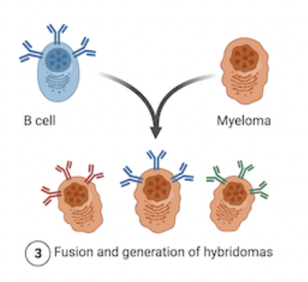
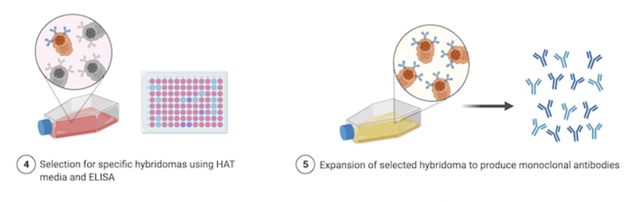

What are antibodies? How are they made?
1970s (Nobel Prize of 1984)
Source: https://blog.addgene.org/antibodies-101-monoclonal-antibodies

Slide 11
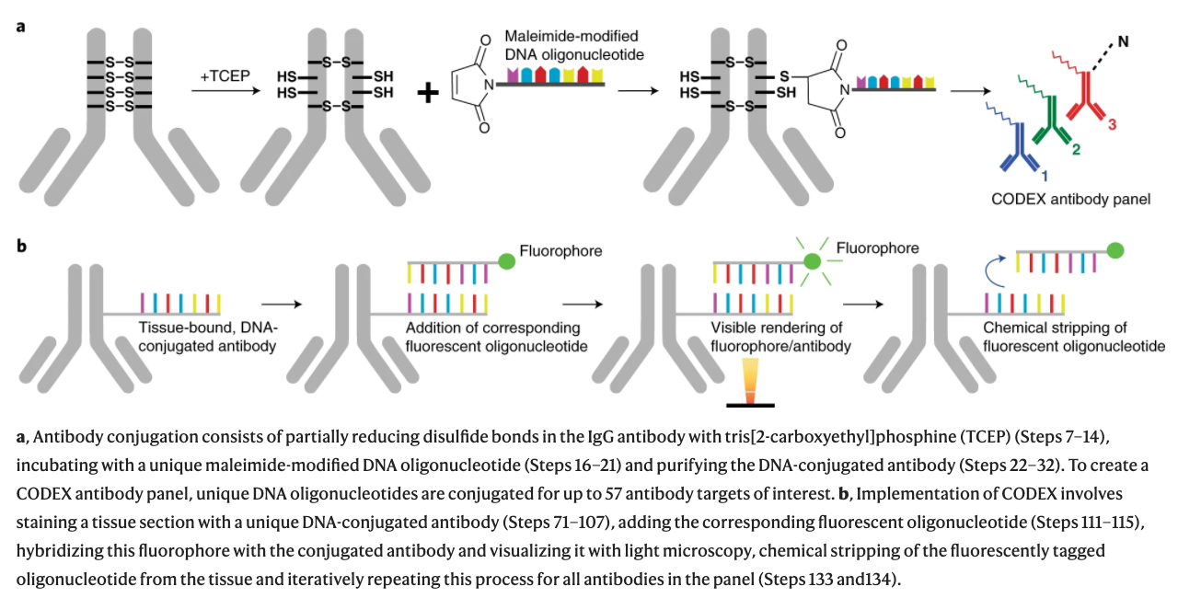
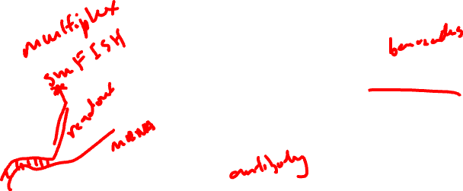
CODEX (CO-Detection by indEXing)
Dr. Gary Nolan at Stanford
Black, et al. Nat Protoc 2021

Slide 12


CODEX (CO-Detection by indEXing)
Dr. Gary Nolan at Stanford
Black, et al. Nat Protoc 2021

Slide 13
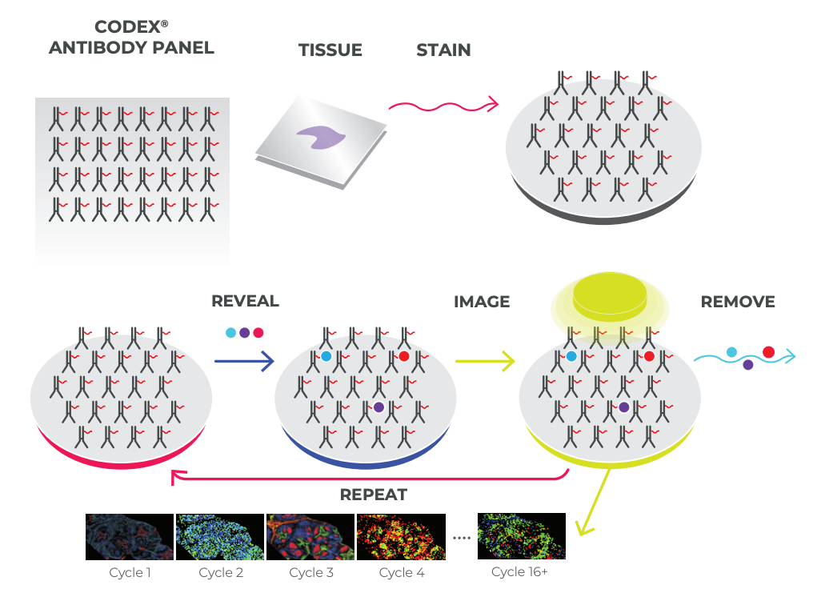
CODEX (CO-Detection by indEXing)
Akoya. Technical Note. Validation of CODEX Antibodies

Slide 14

CODEX (CO-Detection by indEXing)
~40 proteins
Akoya. Technical Note. Validation of CODEX Antibodies

Slide 15
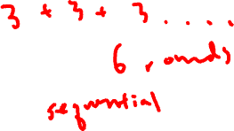
Practice
We want to measure 18 proteins in a tissue
Using CODEX with 3 colors, we can measure 3 proteins in each imaging round
How many rounds of imaging do we need to image all 18 proteins?

Slide 16

Practice
Recall: multiplexed smFISH useds a multiplexing scheme to increase the number of different genes that can be measured
Why do we not using multiplexing for proteins?

Slide 17
What are some potential challenges for characterizing the proteome?

Slide 18
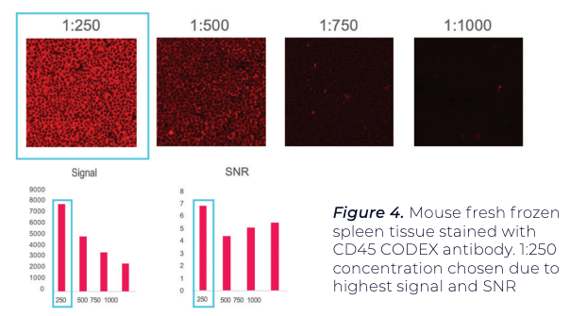
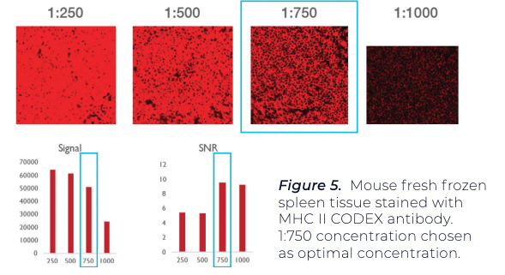

Antibody titration needed to minimize non-specific binding and improve signal to noise ratio
Using positive test tissue, maximize signal-to-noise ratio (SNR) and average signal.
A threshold is set for both signal and noise.
A binary map is used to confirm that pixels associated with signal and noise
Antibody A
Antibody B

Slide 19
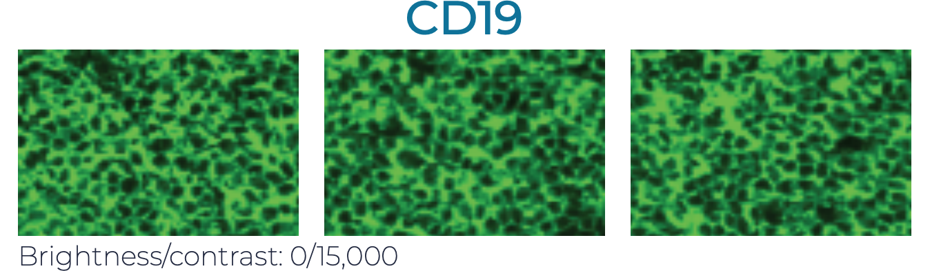
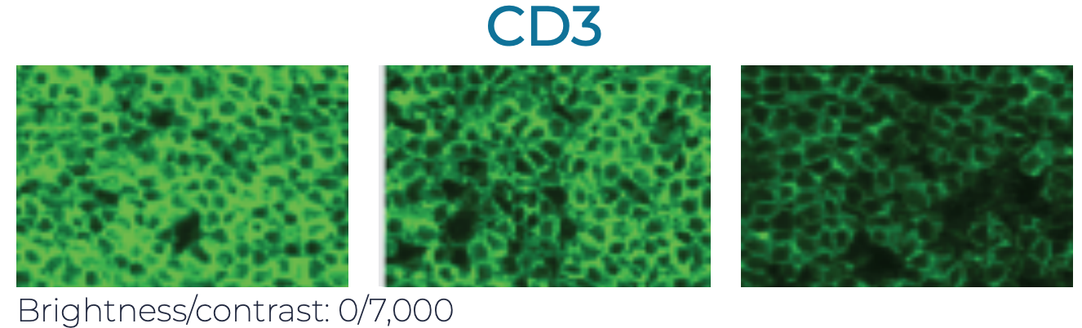

Antibodies may interfere with each other (steric hindrance)
Even if it works well by itself, it may not give the same performance when used in combination with others. Therefore need to test:
Individually
In the presence of a few other antibodies (positive and negative counterstains)
In the presence of many other antibodies
1
2
3

Slide 20
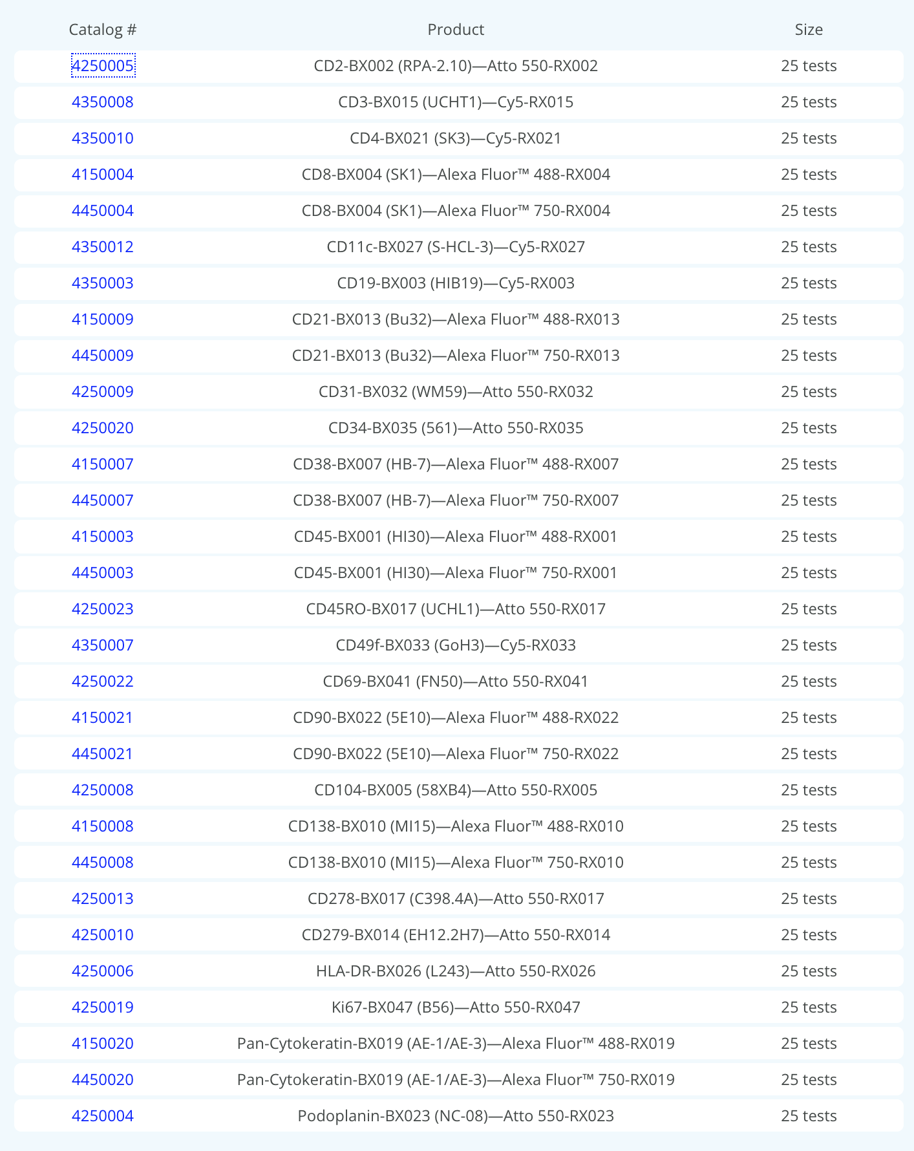
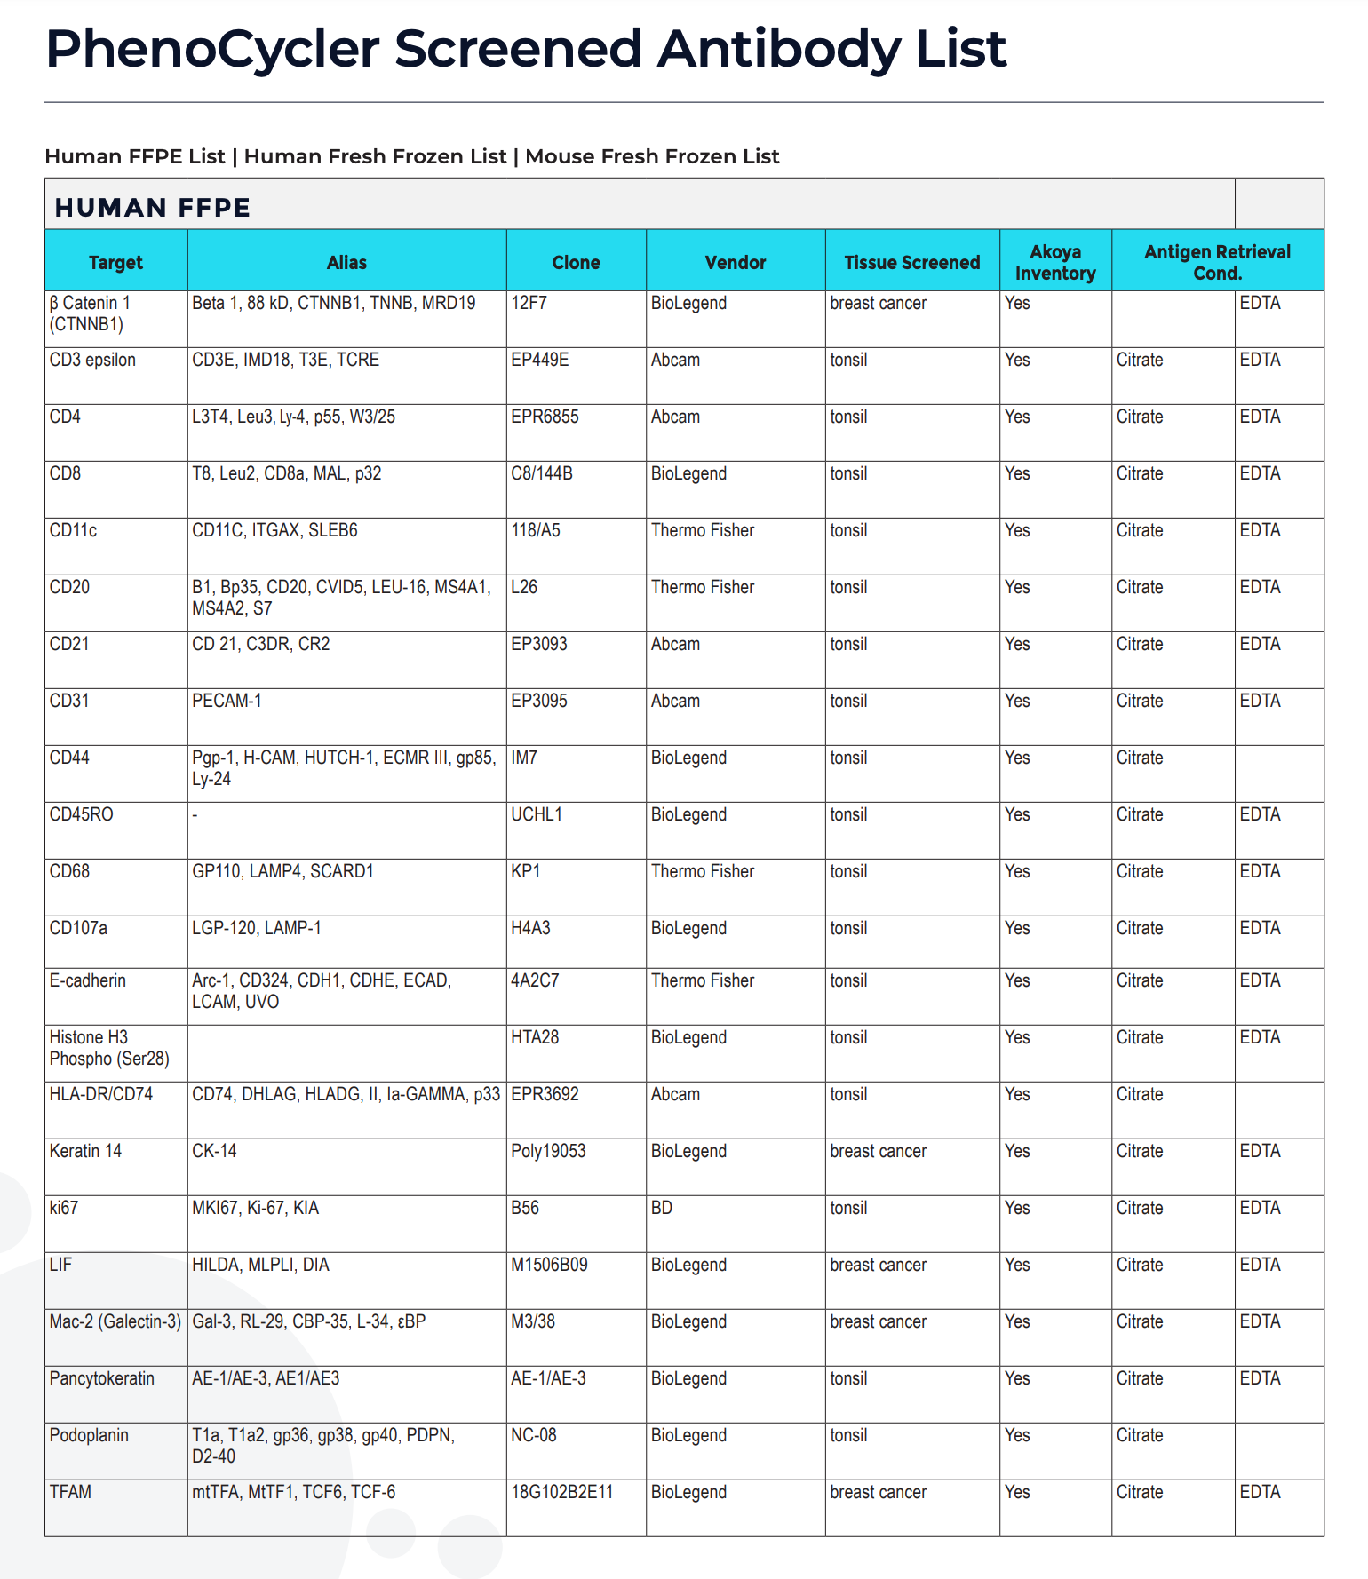

Antibodies for proteins of interest may not be available
~ 30 approved (work well together)
~ 300 screened (unclear if will work well together)
How many different proteins are in the proteome?
(on the order of)
Recall we have ~20k different RNAs
Notes:
80,000 to 400,000 proteins

Slide 21

Practice question
GeneA and GeneB are upregulated in microglia, Prof. Fan’s cell-type of interest
GeneA encodes for a secreted protein ProteinA
GeneB encodes for a nuclear protein ProteinB
Good antibodies are available for both proteins
Prof. Fan wants to stain for one of these proteins to identify microglia in the brain and study their spatial organization
Which protein should she stain for and why?

Slide 22
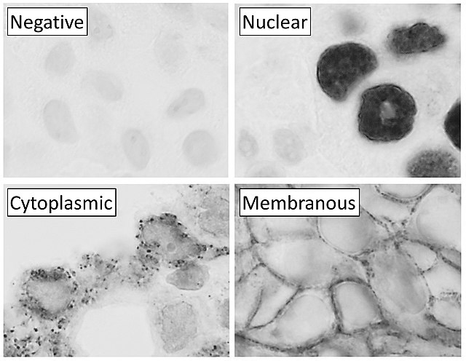


Slide 23
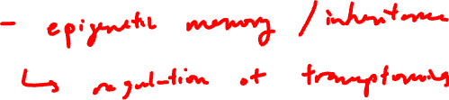
Why epigenetics?

Slide 24
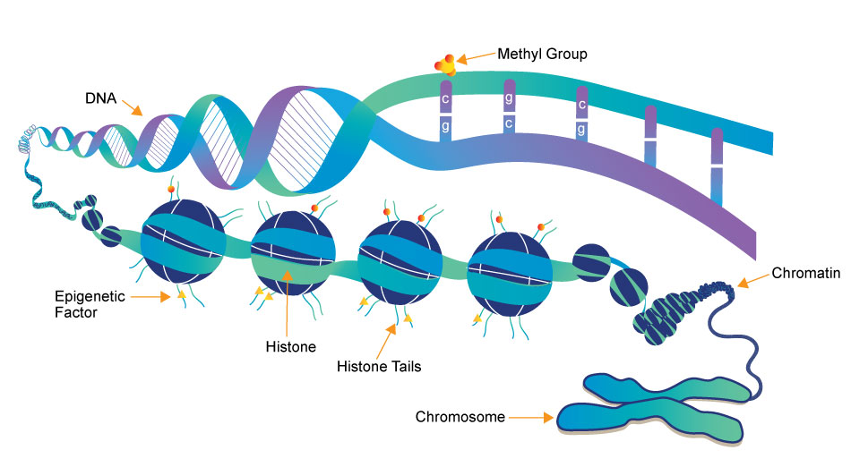
(a type of
protein)
Source: https://www.whatisepigenetics.com/fundamentals/

Slide 25
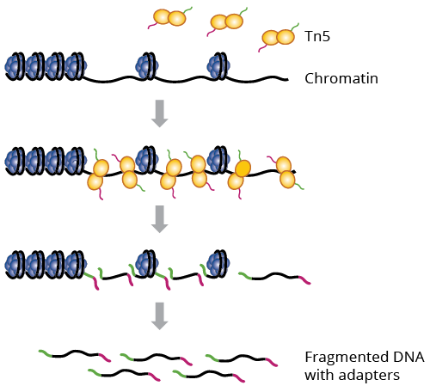

What parts of DNA are accessible for transcription?
ATAC-seq: Assay for Transposase-Accessible Chromatin using Sequencing
Why could this be interesting?
a genetically engineered hyperactive Tn5 transposase (2013) that simultaneously cuts open chromatin leaving a staggered nick and ligates sequencing adapters to these regions

Slide 26


Interpreting ATAC-seq data
Sequence:
Alignment:
Genome

Slide 27
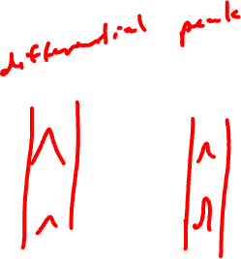
Visualizing ATAC-seq data
Cell-type A
Cell-type B
genes
Genome

Slide 28

Food for thought
Many many RNA molecules are in a typical mammalian cell?
How many accessible regions are in the genome of a mammalian cell?
Notes:
Approximately 360,000 mRNA molecules are present in a single mammalian cell, made up of approximately 12,000 different transcripts with a typical length of around 2 kb.

Slide 29
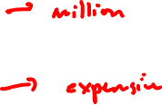
Food for thought
If I want to sequence every RNA molecule, at least how many reads do I need to sequence?
If I want to sequence every accessible region, at least how many reads do I need to sequence?

Slide 30
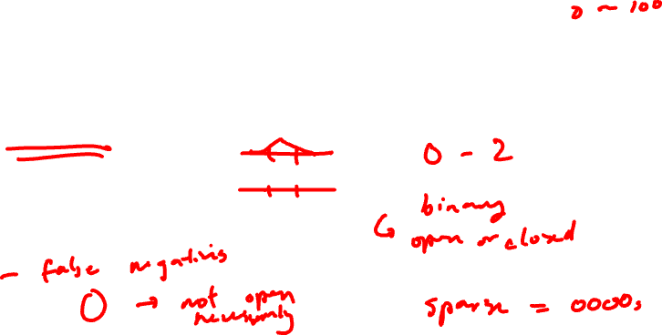
Food for thought
We’ve seen a range of measurements for gene expression (0 to X copies) in a single cell
What is the range of measurements you expect for accessibility data in a single cell?

Slide 31
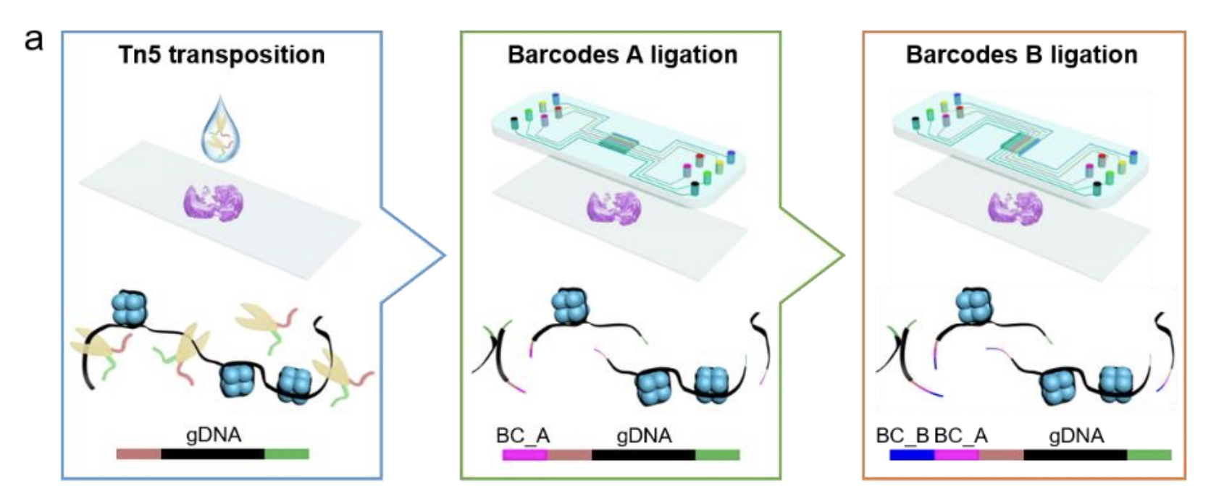
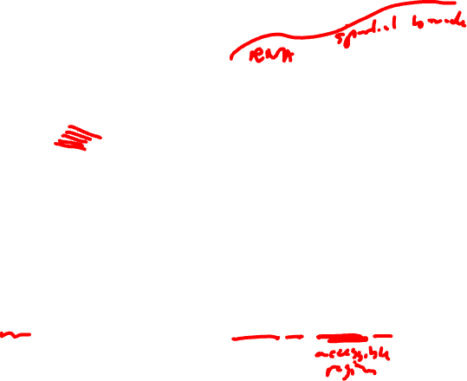
Getting to spatially resolved by sequencing (spatial ATAC-seq via DBiT-seq)
Source: https://www.biorxiv.org/content/10.1101/2021.06.06.447244v1

Slide 32
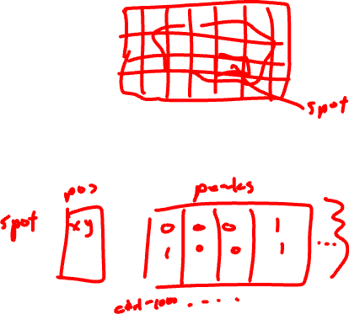
Spatial ATAC-seq
Still get count and position matrix
Instead of spot by gene, we get spot by DNA region
In theory, we can cluster and do all the same analyses as spatial transcriptomics

Slide 33
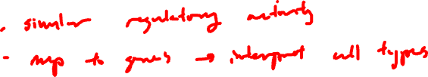
Practice Question
In spatial transcriptomics analysis, clusters of cells are transcriptionally similar (express similar genes). What do these spatial ATAC-seq clusters mean?

Slide 34

Practice Question
In spatial transcriptomics analysis, differential testing could help us identify which genes were upregulated in clusters. Can we do differential testing with ATAC-seq?
How would you interpret the results?

Slide 35
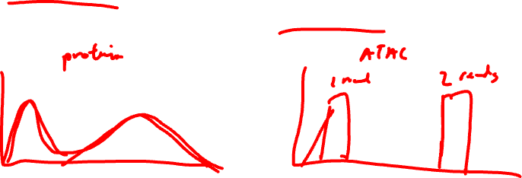
Food for thought
In spatial proteomics, we talked about how if we don’t titrate antibodies appropriately, we can get a lot of non-specific binding resulting in false positives (detecting proteins where there are none)
Are we more likely to get false positives or false negatives with spatial atac-seq?

Slide 36
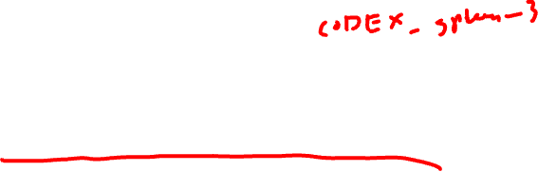
HW5 – analyze a CODEX dataset
Perform a full analysis (quality control, dimensionality reduction, kmeans clustering, differential expression analysis) on your data. Your goal is to figure out what tissue structure is represented in the CODEX data. Options include: (1) Artery/Vein, (2) White pulp, (3) Red pulp, (4) Capsule/Trabecula
You will need to visualize and interpret at least two cell-types. Create a data visualization and write a description to convince me that your interpretation is correct.
Your description should reference papers and content that allowed you to interpret your cell clusters as a particular cell-types. You must provide attribution to external resources referenced. Links are fine; formatted references are not required.
You must include the entire code you used to generate the figure so that it can be reproduced.

